Slide 1
COSC2446: Web Programming
Basic JavaScript

Slide 2
JavaScript
is a programming language
is not the same as Java
has been created to make web pages more interactive

Slide 3
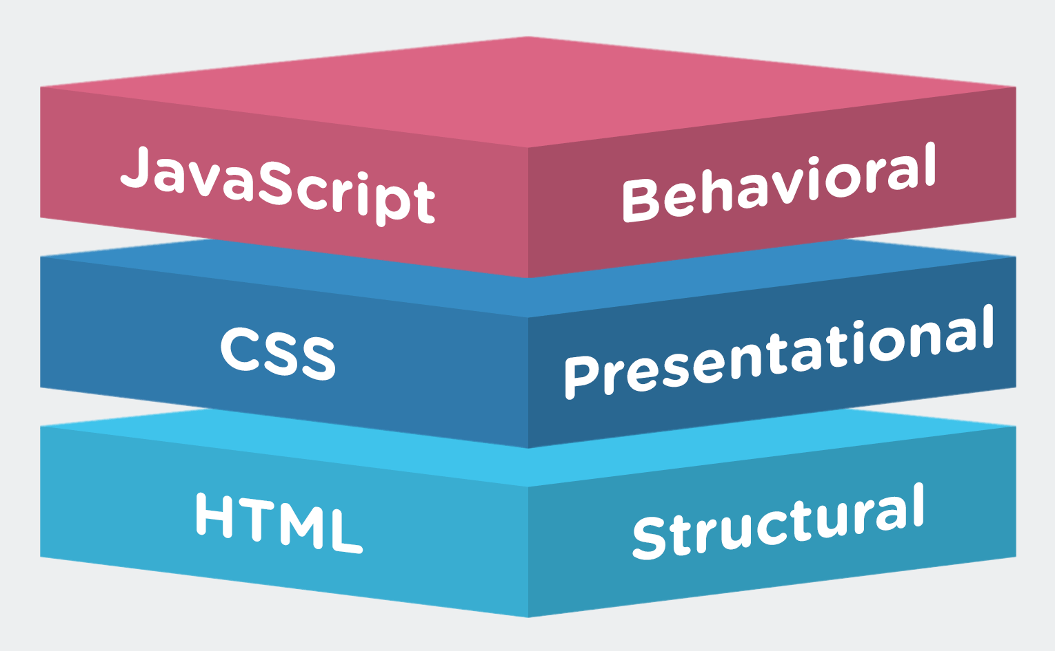
HTML, CSS & JavaScript
https://www.1training.org/blog/html-css-javascript-web-development/

Slide 4
JavaScript is Heavily Used
This week and next week we will look at how basic JavaScript works.
Then we will learn Bootstrap, a web development framework that makes heavy use of JavaScript and CSS, but in a way so that you don't have to use them directly.

Slide 5
JavaScript and Java
As most of you are studying both these languages at the same time, it is important to realize some significant differences.

Slide 6
Classes
Java explicitly uses classes. JavaScript is moving in this direction but in this course, we don't define a class for our JavaScript code

Slide 7
main method
Java requires a method (like a function) called main to run a program. This is not necessary in JavaScript; a lot of JavaScript code does not use functions at all.

Slide 8
Types
Since computers store different types of data differently, they sort data into types
int for whole numbers
double for numbers with decimal points
String (short for string of characters) for text
boolean for true/false values
etc.

Slide 9
Java requires to define types, JavaScript doesn't
In Java, you must state what type of value is
In JavaScript, you don't need to state what type the data is, as the computer attempts to guess.
JavaScript does use types and occasionally you need to be explicit to get the right result

Slide 10
C – The Common Ancestor
Both Java and JavaScript had a common ancestor language (the C programming language) and have a lot in common, for example, the use of braces {}, parentheses (), semi-colons ; to end statements, common rules for naming things, and lots of common syntax such as if/else, for, while, etc.

Slide 11
Where to add JavaScript?
Unlike CSS, you can add JavaScript inside EITHER head OR body element. Or BOTH.
Add JavaScript with tags <script></script>

Slide 12
Internal JavaScript
In the same html file:
<script>
alert("Hello");
</script>

Slide 13
External JavaScript
In a separate .js file:
<script src="js/external.js"></script>
Advantages:
It separates HTML and code
It makes HTML and JavaScript easier to read and maintain
Cached JavaScript files can speed up page loads
Can be used on more than one html page (Assessment 1)

Slide 14
Let's get started…
A simple JavaScript example
use a script element in the body of the web page
inside this element write some JavaScript
note the style of comment in the code
the example should display a little message box when you view the page
js_01

Slide 15
Using console.log
Instead of using the alert message box, we can use console.log to print messages to an area called the Console, accessed by right-clicking on the web page and selecting "Inspect”.
Please note that console.log() is used only for debugging and messages to developers, as there is nothing will be displayed on the page.
js_02

Slide 16
External JavaScript
Scripts can also be placed in external files: External scripts are practical when the same code is used in many different web pages.
JavaScript files have the file extension .js.
To use an external script, put the name of the script file in the src (source) attribute of a <script> tag:
Example
<script src="myScript.js"></script>
You can place an external script reference in <head> or <body> as you like.
The script will behave as if it were located exactly where the <script> tag is located.

Slide 17
Variables
JavaScript stores data in named locations called variables.
There are 3 ways to declare a JavaScript variable:
Using var
Using let
Using const

Slide 18
Variables - var
Create a variable with the keyword var followed by the name, and then give it a value like this
var age = 23; //whole number
var height = 1.72; //decimal number
var name = "John"; //text (also called string)
//double slash indicates a comment

Slide 19
Variables - let
The let keyword was introduced in ES6 (2015).
Variables defined with let cannot be Redeclared. With var you can.
Variables defined with let must be Declared before use.
Variables defined with let have Block Scope - inside the block denoted by {}.

Slide 20
Variables – block scope
Variables declared inside a { } block cannot be accessed from outside the block:
{ let x = 2; } // x can NOT be used here

Slide 21
Variables – var scope
Variables declared with the var keyword can NOT have block scope.
Variables declared with the var keyword inside a { } block can be accessed from outside the block.
{ var x = 2; } // x CAN be used here

Slide 22
Variables – const
The const keyword was introduced in ES6 (2015).
Variables defined with const cannot be Redeclared.
Variables defined with const cannot be Reassigned.
Variables defined with const have Block Scope.
const PI = 3.14159265359;

Slide 23
Variable names
can contain letters, digits, underscore _ and dollar $ characters
cannot begin with a digit
are case sensitive – age and Age are different variable names
keywords and other reserved words cannot be used

Slide 24
Keywords – the basic language vocabulary
boolean, break, byte, case, catch, char, const, do, double, else, false, float, for, function, if, new, null, package, private, public, return, switch, this, throw, throws, true, try, typeof, var, void, while, with
There are a few others but they are less frequently used.

Slide 25
Changing the value of a variable
Once a variable is declared with the keyword var or let, we don't need to use that again to assign a new value:
var x = 3;
//do something with x
x = 4;

Slide 26
Text variables
In programming languages, text is commonly called a string, short for a string of characters.
To assign a string to a variable it must be in quotes, single quotes or double quotes both work in JavaScript
var address = "23 Main St";
var suburb = 'Carlton';

Slide 27
Use a variable in a script (program)
We have seen how to use literal values, e.g.
alert("hello");
We can do this with a variable instead, e.g.
var greeting = "hello";
alert(greeting);
Note that the variable name does not go in quotes, only the original text.
js_03

Slide 28
Array variables
An array is like an apartment block – several values stored under the one variable name
Each value has an index number, like the unit number in an apartment block
The index number is written after the variable name, e.g. scores[3]
Index numbering starts at zero

Slide 29
An Array of whole numbers
//declare the array and assign values
var primes = [2, 3, 5, 7, 11, 13];
//access the values
alert(primes[0]);
//this will print the number 2

Slide 30
Array Processing
One advantage of an array is that it is easy to process all the data with very little code. The following example prints all the prime numbers onto a page using another output method – document.write()
js_04

Slide 31
Array of Images
It is common to store a set of images in an array and use JavaScript to display them.
js_05

Slide 32
Objects
JavaScript has another type of data storage called an object. The syntax is a bit different from arrays.
var book = {
title: "Let the Right One In",
author: "John Ajvide Lindqvist",
published: 2005 }

Slide 33
Access Object Properties
The properties of the object are accessed a bit differently from arrays as well, with variablename.propertyname
console.log(book.title);
console.log(book.author);
console.log(book.published);

Slide 34
Book Object
js_06

Slide 35
Objects and Loops
One can iterate (go through a list) all the properties of an object using a for loop. Using this looks more like an array than an object.
for(p in book)
{
document.write(p + ": " + book[p] + "<br>");
}

Slide 36
Predefined Objects
A web browser has several predefined objects that can be accessed using JavaScript
window
navigator
screen
document
console

Slide 37
Properties of Predefined Objects
One can iterate through the properties of predefined objects in the same way that we did for the book example. See the exercises.

Slide 38
End of Presentation

